Slide 1
Lab 6
C code with the ARM Processor
Julio César Almada Fuerte
A00226046
ITE

Slide 2
Part 1
Make a program on C that looks for the largest number on a list, and prints the result.
Follow the same steps to build a Project except the ones from the next slide.

Slide 3
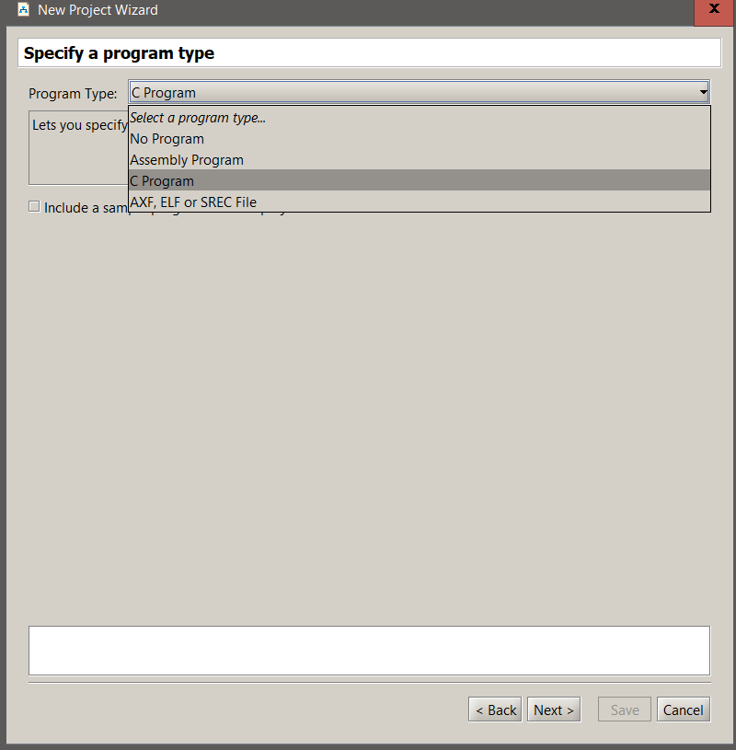
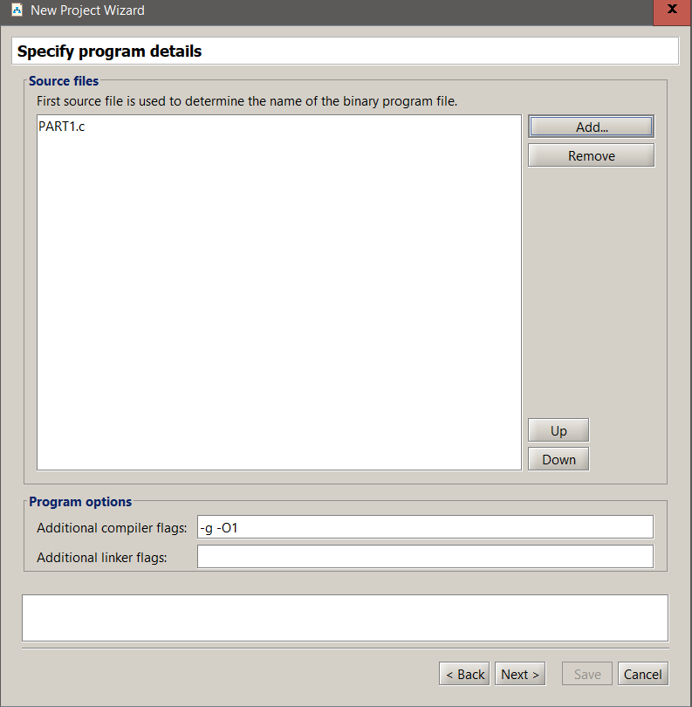

Slide 4
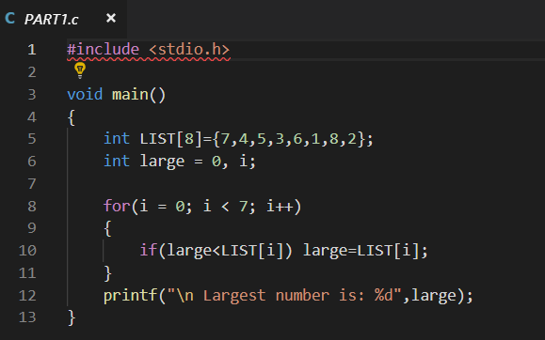

Slide 5
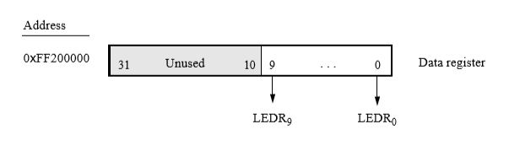
Part 2
Do the same as part 1 but instead of displaying the result with a printf statement, display it with the LEDs on the DE10-Standard.
Writing a value to the 0xFF200000 register will turn on the LEDs corresponding to each LED.

Slide 6
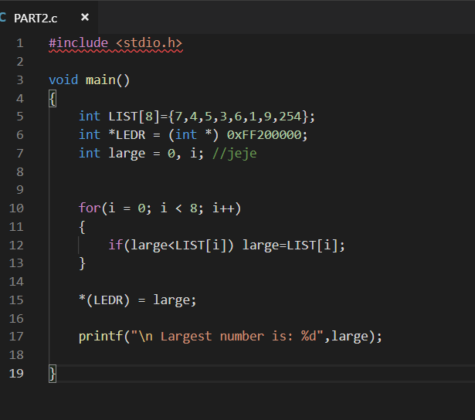

Slide 7
Part 3
Find the longest strings of 1’s, 0’s and alternating strings and display them on the 7 – segments.

Slide 8
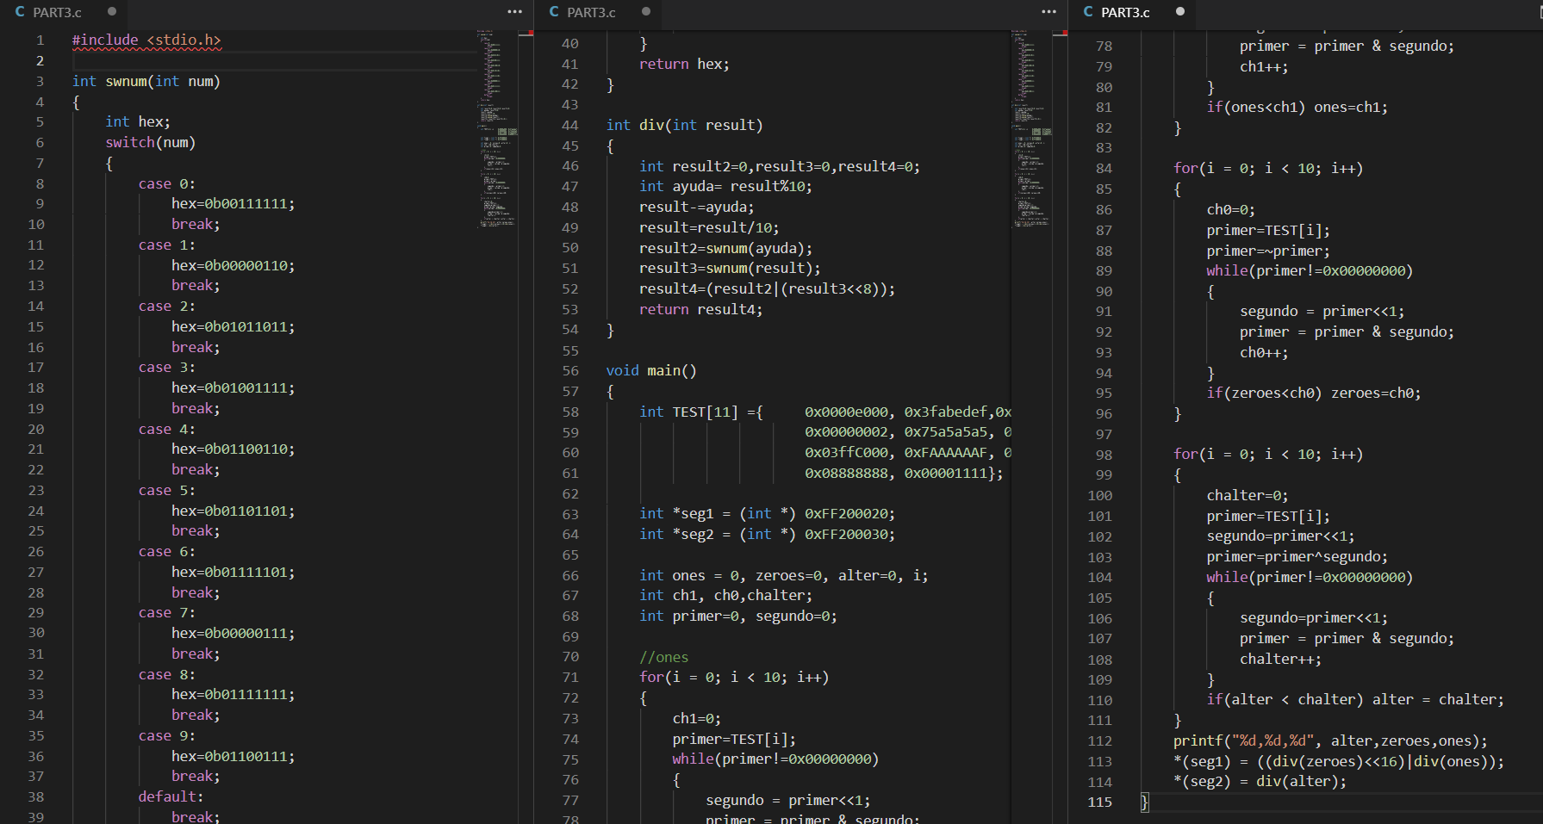

Slide 9
Part 4
Implement a real time clock, using the A9 timer.(MM:SS:DD)
Use the buttons to run/stop the clock.

Slide 10
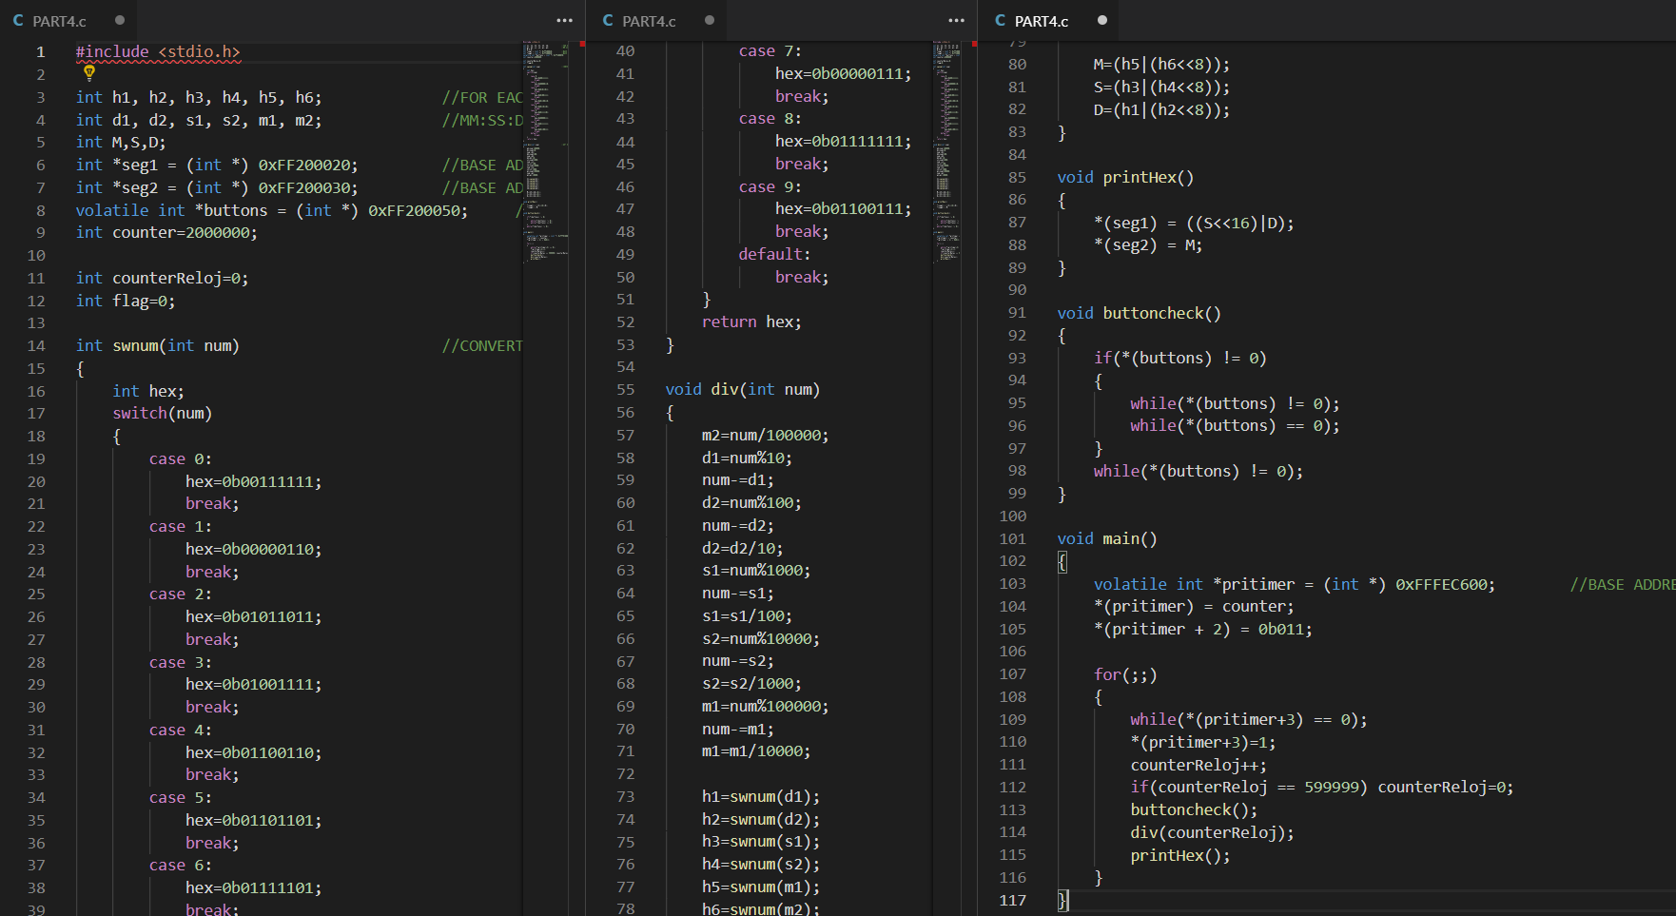

Slide 11
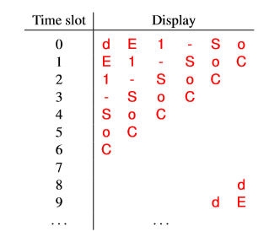
PART 5
C program that scrolls the message “dE1-SoC” in the right to left direction across the 7 segment display.
It should scroll at a rate of .2 seconds per
character.
You should be able to run/stop the message by
pressing any button.

Slide 12
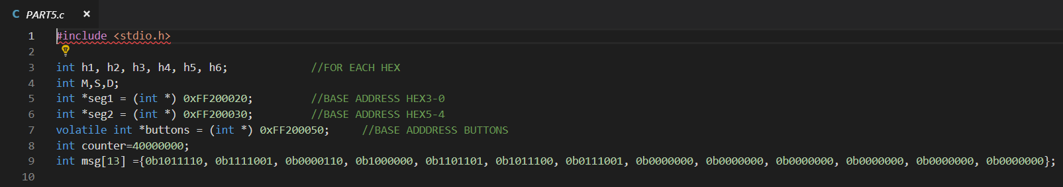

Slide 13
